Slide 1
COP528 Applied Machine Learning
2021-2022, Semester 2
March 2022

Slide 2
Contact
Lecturer: Dr. Hui Fang
E-mail: h.fang@lboro.ac.uk
Office: N. 202
Consultation hours: by agreement
Teaching Assistant: Colin Yuan, Yifan Wang
E-mail: k.yuan@lboro.ac.uk, y.wang6@lboro.ac.uk
Office: N. 215

Slide 3
Intended Learning Outcomes
1. Knowledge and Understanding
Understand theories of machine learning (ML) methods.
Critically analyse the methods under various of scenarios.
2. Skills and Attributes:
Evaluate state-of-the-art ML methods.
Select suitable ML methods for specific tasks.
Design ML pipelines to solve real-world problems, e.g., classification and clustering tasks.
Appraise ML methods in different applicable fields.

Slide 4
Module Overview
Lecture: 20 Hrs
Lab: 25 hrs
Independent study: 105 Hrs
Total: 150 hrs, 15 credits
Assessment: one coursework 100%
10 days over two weeks
Lectures in the morning
Labs and workshops in the afternoon (8 Labs, 2 drop-in sessions)
Week3: Coursework

Slide 5
Andrew Ng in Stanford:
https://see.stanford.edu/Course/CS229
Learn with Google AI:
https://ai.google/education/
Machine Learning in 14 Days
Start from basics but achieve an insight of each method.
You could communicate with professionals as well non-professionals on ML more effectively.

Slide 6
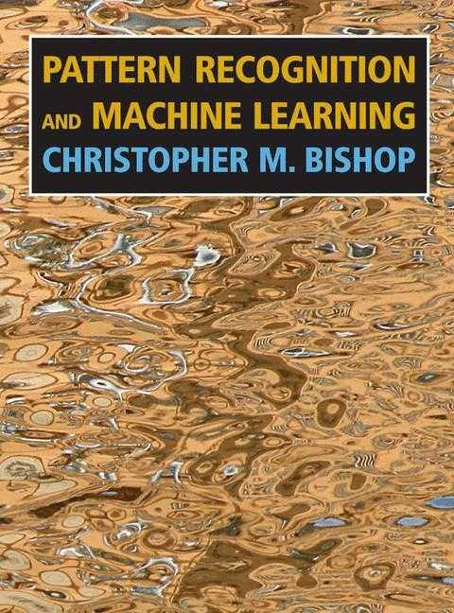
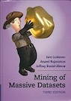
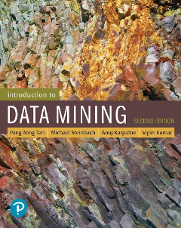
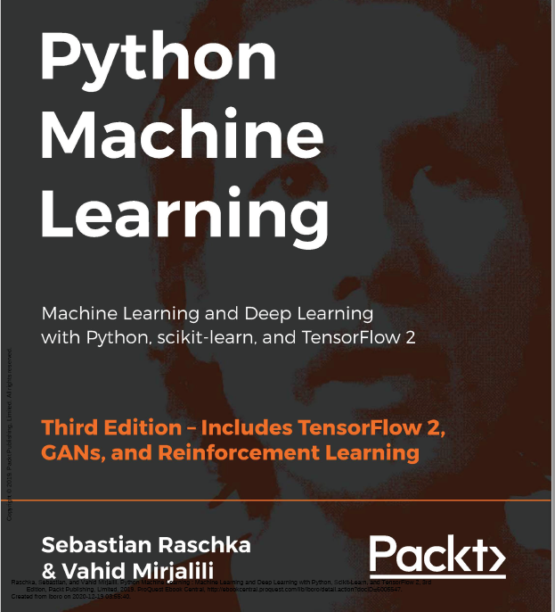
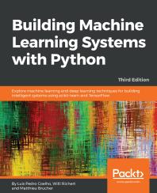
Books that may be useful

Slide 7
Structure and Content of this module
Day 01. Introduction of ML
Day 02. Data Preparation
Day 03. Unsupervised learning 01
Day 04. Unsupervised learning 02
Day 05. Feature selection & Decision Tree
Day 06. SVM & kNN
Day 07. Neural Network
Day 08. Convolutional Neural Network
Day 09. Ensemble learning
Day 10. Dimension reduction

Slide 8
Day 01. Introduction

Slide 9
Applied Machine Learning
“Applied”:
Medical data/image analysis
Agriculture related projects
Business intelligence
Computer vision
Chatbots
Autonomous driving
Routing planning and optimization
Recommendation system
…

Slide 10
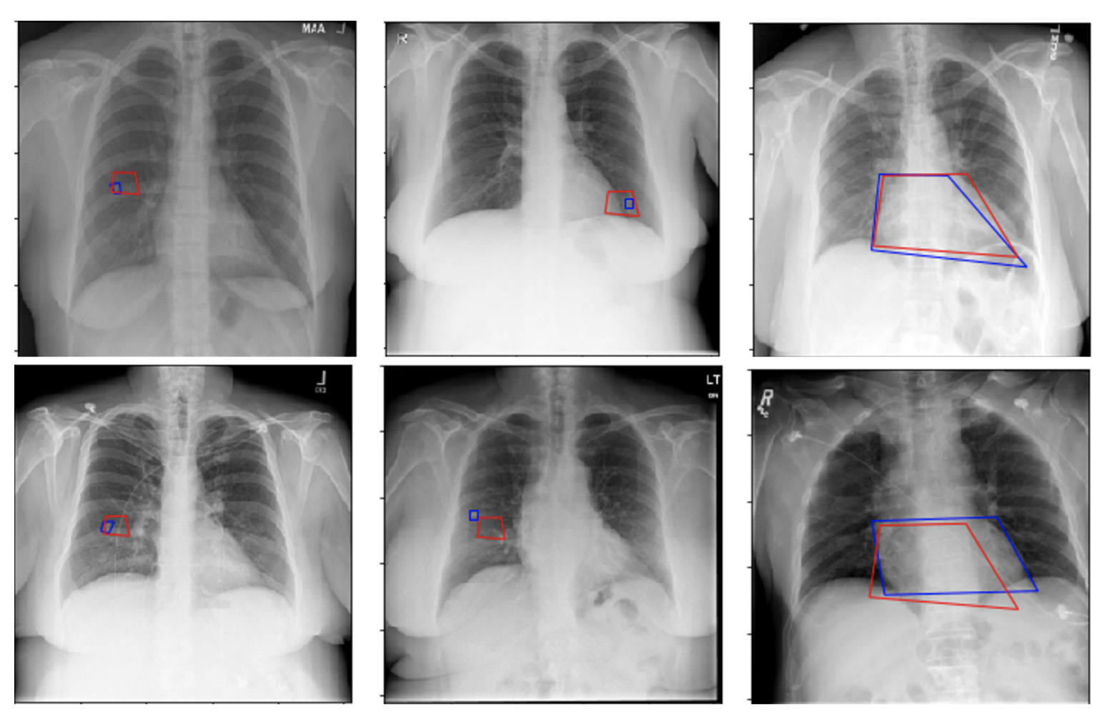
Applied Machine Learning
An IBM study that autonomously located potential health threats in chest X-rays with a level of accuracy (red) comparable to that of experienced radiologists analysing (blue) and annotating the same images.

Slide 11
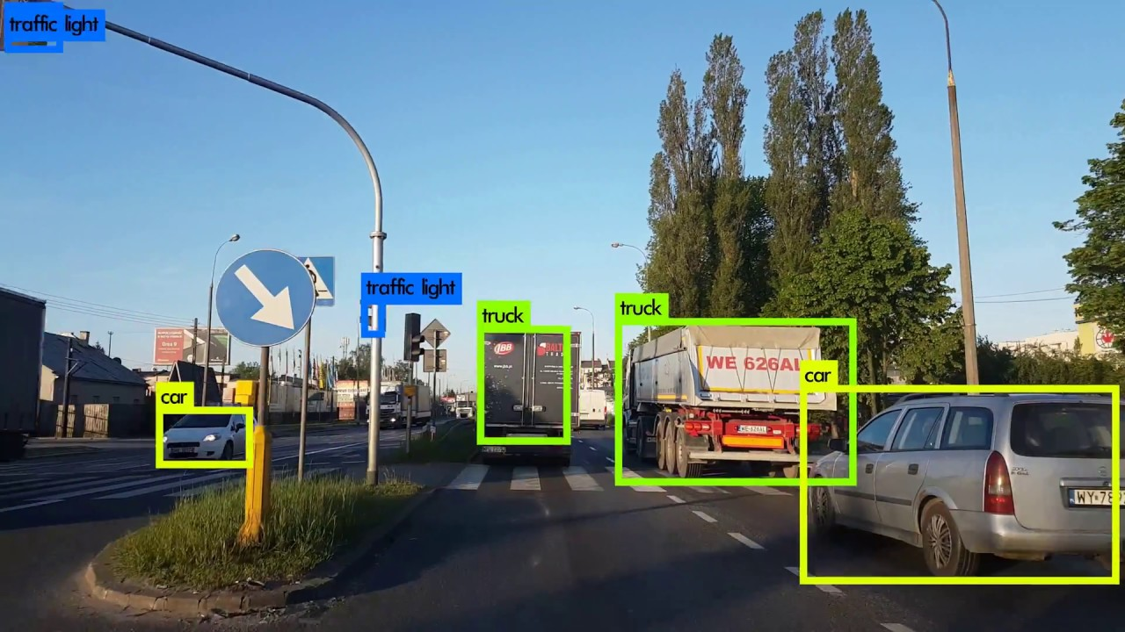
Applied Machine Learning

Slide 12
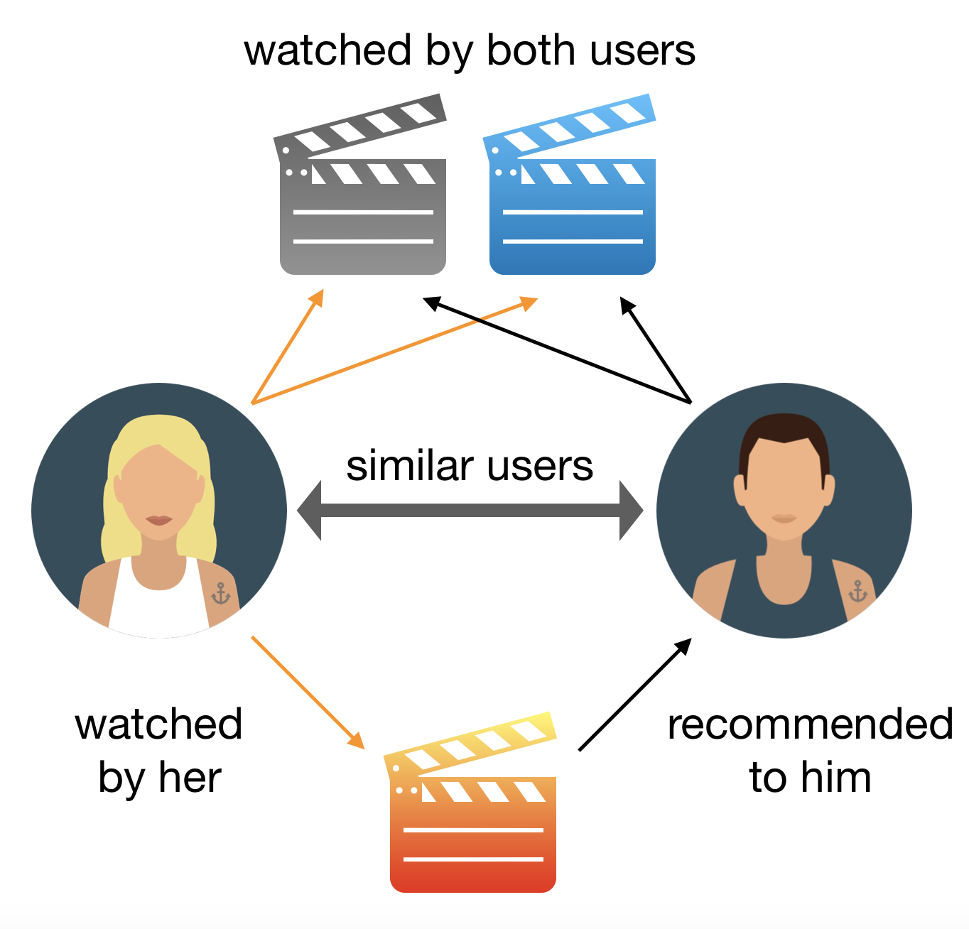
Applied Machine Learning

Slide 13
Machine Learning
Black-box perspective of ML:
A function learned by a computer/cluster that maps input observations to output predictions.

Slide 14
Definition
Machine Learning seeks to develop theories and computer systems for
representing;
classifying, clustering, recognizing, organizing;
reasoning under uncertainty;
predicting;
Under complex, real-world data, based on the system's own experience with data, and (hopefully) under a unified model or mathematical framework, that
can be formally characterized and analyzed
can consider human prior knowledge
can generalize and adapt across data and domains
can operate automatically and autonomously
and can be interpreted and perceived by human

Slide 15
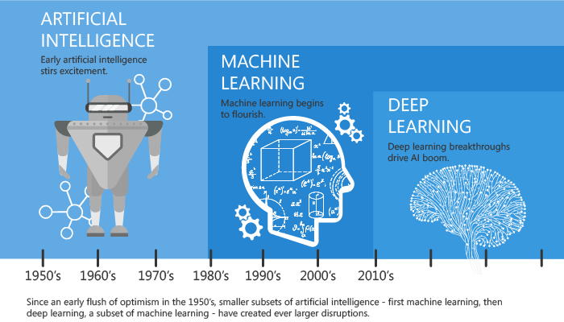
Machine Learning vs. Artificial Intelligence

Slide 16
Machine Learning vs. Data Mining
Machine Learning:
Ultimate goal is to achieve strong AI
Focus on algorithm design
Machine centric (Machine will find patterns and learn)
Data Mining:
It involves a systematic hunt for nuggets of actionable intelligence in the existing data available.
Ultimate goal is to efficiently use data for knowledge discovery.
Focus on the knowledge extracted from data
Human centric (use ML method as supporting tools)

Slide 17
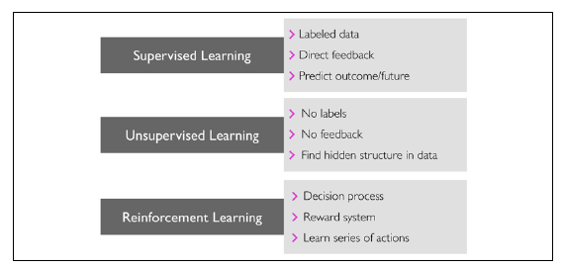
Types of Machine Learning
Semi-supervised learning
Self-supervised learning
Weakly-supervised learning

Slide 18
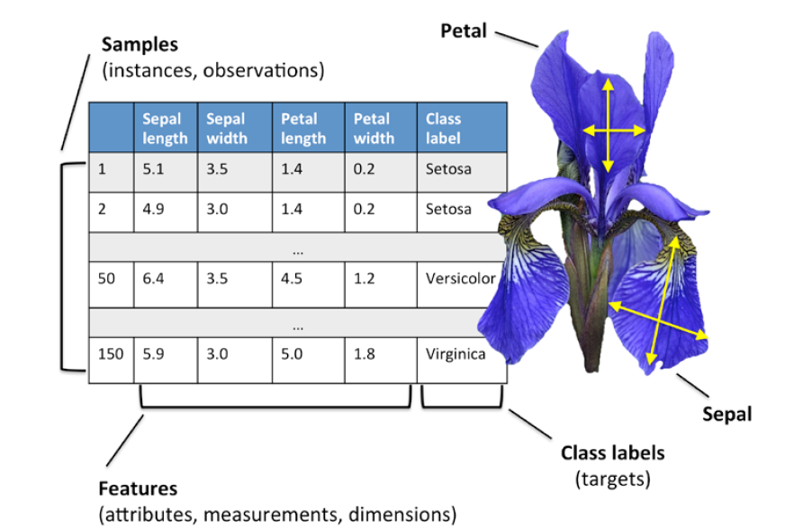
Supervised learning
Supervised learning is learning a function that maps an input to an output based on example input-output pairs. It infers a function from labelled training data consisting of a set of training examples.

Slide 19
Can you name some of the algorithms?
Logistic regression
Naïve Bayes
kNN
Decision Tree
Random Forest
SVM
AdaBoost
xgBoost
MLP Neural Network
Convolutional Neural Network
…

Slide 20
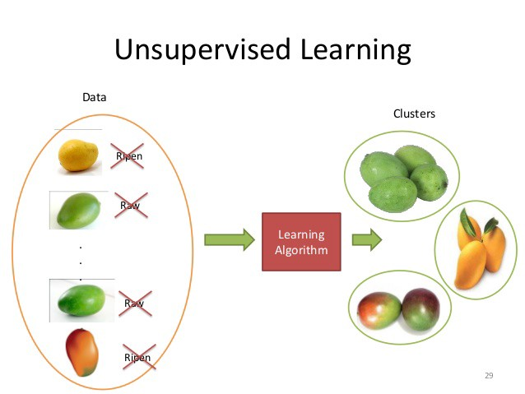
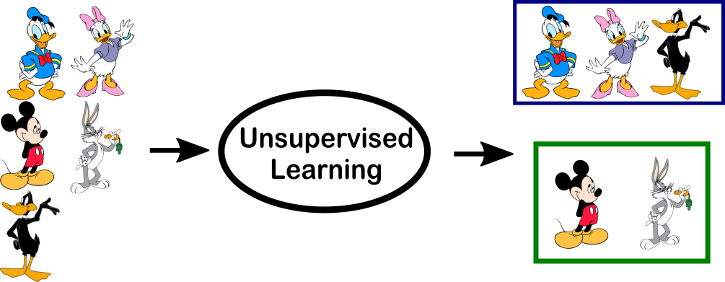
Un-supervised learning
Unsupervised learning utilizes a data set with no pre-existing labels with a minimum of human supervision, often for the purpose of searching for previously undetected patterns.

Slide 21
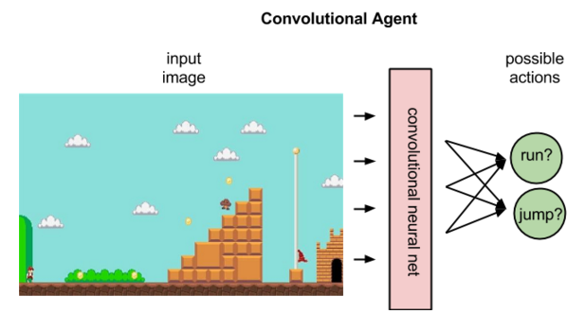
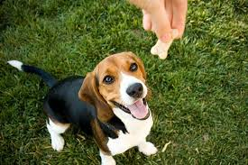
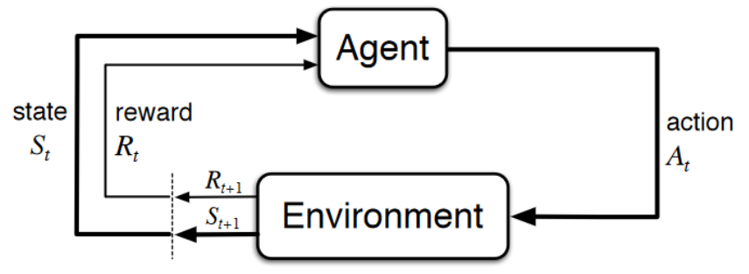
Reinforcement learning
Reinforcement learning (RL) concerned with how intelligent agents ought to take actions in an environment in order to maximize the notion of cumulative reward.

Slide 22
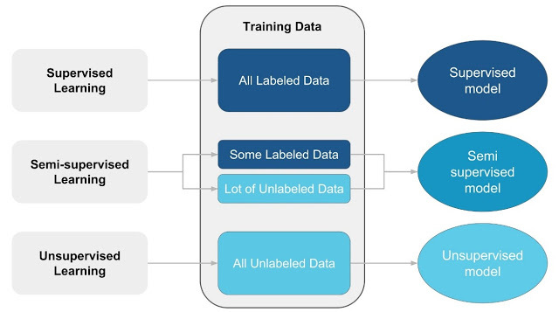
Semi-supervised learning
Semi-supervised learning combines both the advantage of supervised learning and unsupervised learning to achieve acceptable performance, e.g., domain adaptation and few-shot learning.

Slide 23
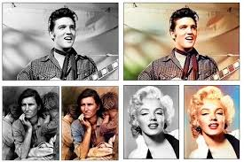
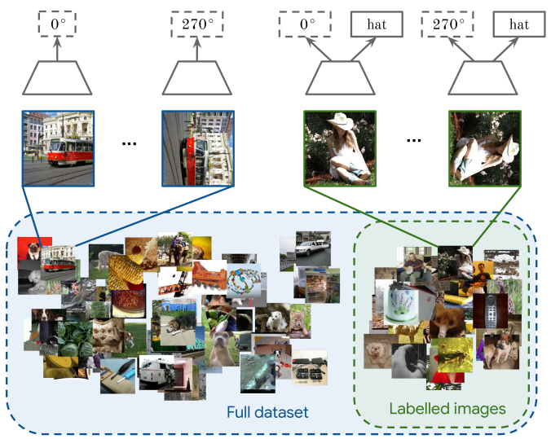
Self-supervised learning
Automatically generate some kind of supervisory signal to solve some task (typically, to learn representations of the data or to automatically label a dataset).

Slide 24
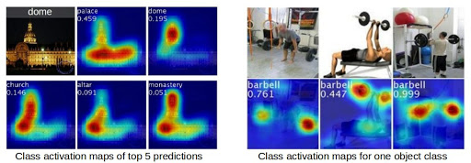
Weak-supervised learning
Weakly supervised learning is an umbrella covering several processes which attempt to build predictive models by learning with weak supervision.

Slide 25
What will be covered in the module
Supervised learning (80%)
Unsupervised learning (20%)

Slide 26
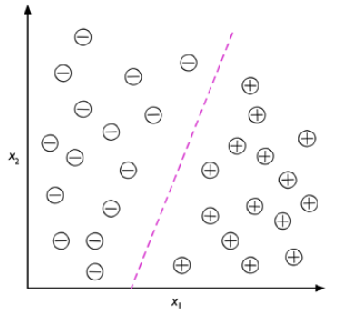
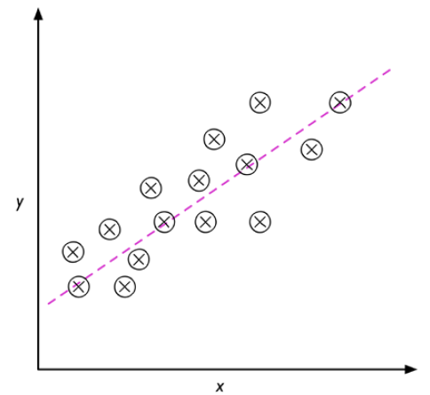
Supervised learning
Types of supervised learning:
Classification
Linear Classifiers
Non-linear Classifiers
Regression
Linear Regressors
Non-linear Regressors

Slide 27
Classification vs. Regression
Classification is a subcategory of supervised learning where the goal is to predict the categorical class labels of new instances, based on past observations.
A second type of supervised learning is the prediction of continuous outcomes, which is also called regression analysis. In regression analysis, we are given a number of predictor (explanatory) variables and a continuous response variable (outcome), and we try to find a relationship between those variables that allows us to predict an outcome.

Slide 28
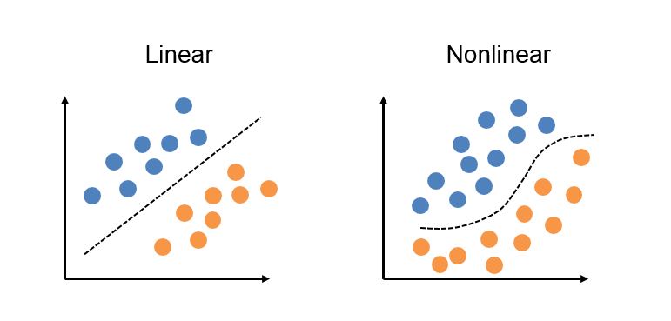
Linear or non-linear classifier

Slide 29
A simple linear classifier model
Output Y is 1 if at least two of the three inputs are equal to 1.

Slide 30
Linear classifier model

Slide 31
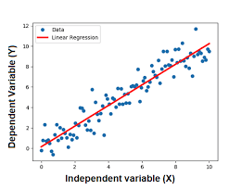
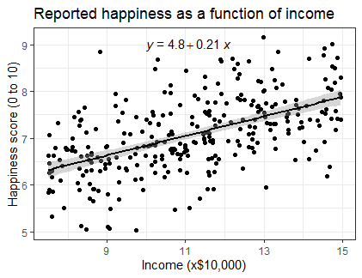
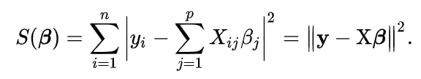
A simple linear regressor

Slide 32
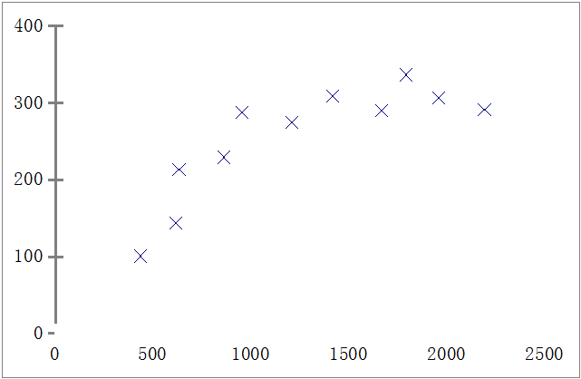
Linear or non-linear regressor
Price ($)
in 1000’s
Size in feet²

Slide 33
Question
Linear and Non-linear systems, which do you think is better?

Slide 34
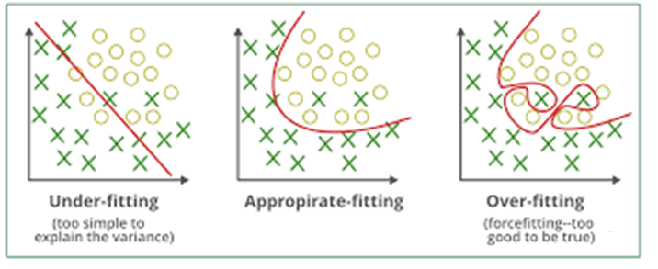
Overfitting problem
Similar to human being, the pattern found from the data is balanced between accuracy and overfitting

Slide 35
No Free-lunch Theorem
Each classification algorithm has its inherent biases, and no single classification model enjoys superiority if we don't make any assumptions about the task.
No model is perfect!
How do we know which model performs well on the
final test dataset and real-world data if we don't use this test dataset for the model selection,
but keep it for the final model evaluation?
Notes:
In a famous 1996 paper , 11 David Wolpert demonstrated that if you make absolutely no assumption about the data, then there is no reason to prefer one model over any other. This is called the No Free Lunch (NFL) theorem.

Slide 36
Model Evaluation

Slide 37
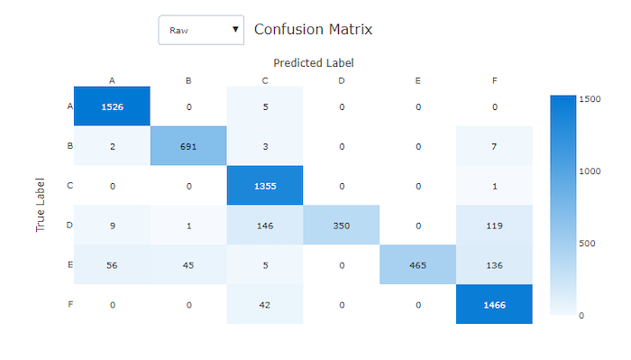
Confusion Matrix
A confusion matrix, also known as an error matrix is a specific table layout that allows visualization of the performance of an algorithm

Slide 38
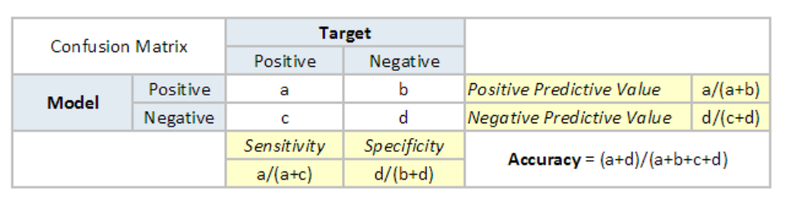
Classification Model Evaluation
A true positive (a) is an outcome where the model correctly predicts the positive class. Similarly, a true negative (d) is an outcome where the model correctly predicts the negative class.
A false positive (b) is an outcome where the model incorrectly predicts the positive class. And a false negative (c) is an outcome where the model incorrectly predicts the negative class.

Slide 39
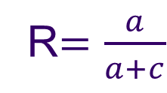
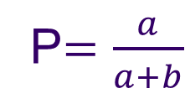
Trade-off – Precision vs Recall
Precision (P) is defined as the number of true positives (a) over the number of true positives plus the number of false positives (b).
P$=\frac{a}{a+b}$
Recall (R) is defined as the number of true positives (a) over the number of true positives plus the number of false negatives (c).
R$=\frac{a}{a+c}$

Slide 40
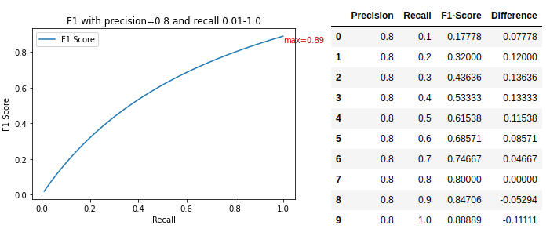
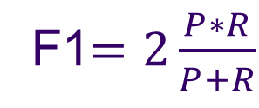
F1 Score
F1 is the harmonic mean of precision and recall for evaluating classification models.
F1$=2\frac{P∗R}{P+R}$

Slide 41
ROC curve & AUC
The Receiver Operator Characteristic (ROC) curve is an evaluation metric for binary classification problems. It is a probability curve that plots the True Positive Rate against False Positive Rate at various threshold values.
The Area Under the Curve (AUC) is the measure of the ability of a classifier to distinguish between classes and is used as a summary of the ROC curve.
The higher the AUC, the better the performance of the model at distinguishing between the positive and negative classes.

Slide 42
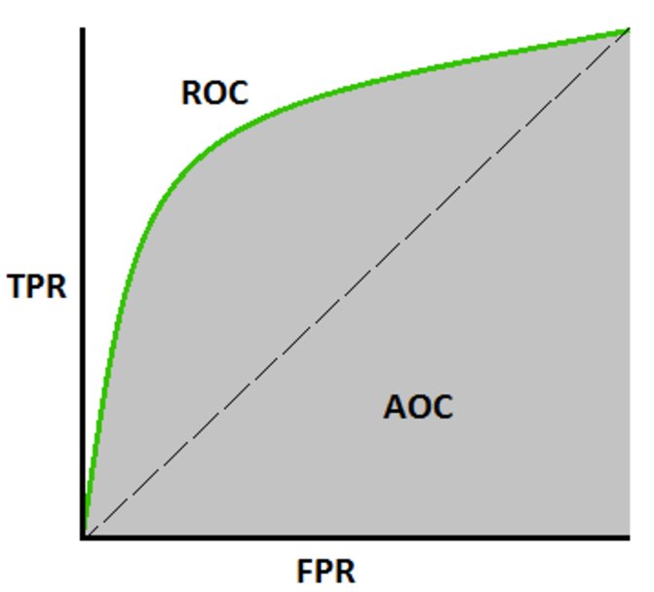
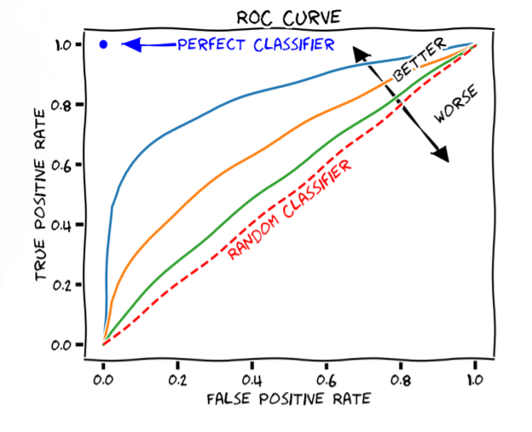
ROC curve & AUC
TPR/Recall/Sensitivity = $\frac{a}{a+c}$, FPR = 1 - Specificity $= \frac{b}{d+b}$

Slide 43
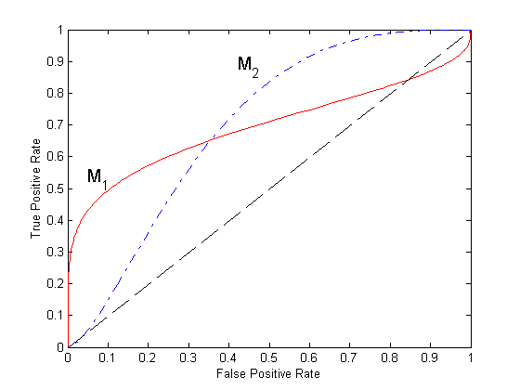
Question time
We have two Models, M1 and M2 and assue both models are built with same settings. Their ROC curves are shown in the figure. Which model performs better?

Slide 44
Comparison of models based on ROC
No model consistently outperform the other
M1 is better for small FPR
M2 is better for large FPR
Area Under the ROC curve (AUC)
Ideal: Area = 1
Random guess:
Area = 0.5

Slide 45
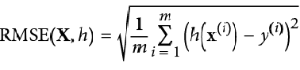
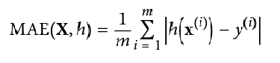
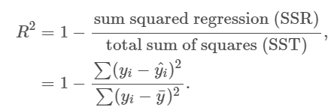
Regression model evaluation
Root Mean Squared Error (RMSE)
Mean Absolute Error (MAE)
R-Squared

Slide 46
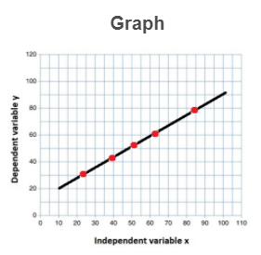
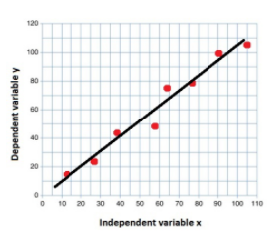
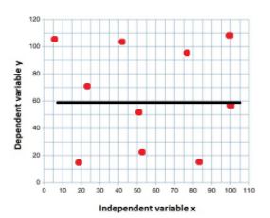
Coefficient of Determination - R-Squared
R² = 1
R² = 0.83
R² = 0

Slide 47
Some key ML terminology
• Training example: A row in a table representing the dataset and synonymous with an observation, record, instance, or sample (in most contexts, sample refers to a collection of training examples).
• Feature, abbrev. x: A column in a data table or data (design) matrix. Synonymous with predictor, variable, input, attribute, or covariate.
• Target, abbrev. y: Synonymous with outcome, output, response variable, dependent variable, (class) label, and ground truth.
• Loss function: Often used synonymously with a cost function. Sometimes the loss function is also called an error function. In some literature, the term "loss" refers to the loss measured for a single data point, and the cost is a measurement that computes the loss (average or summed) over the entire dataset.

Slide 48
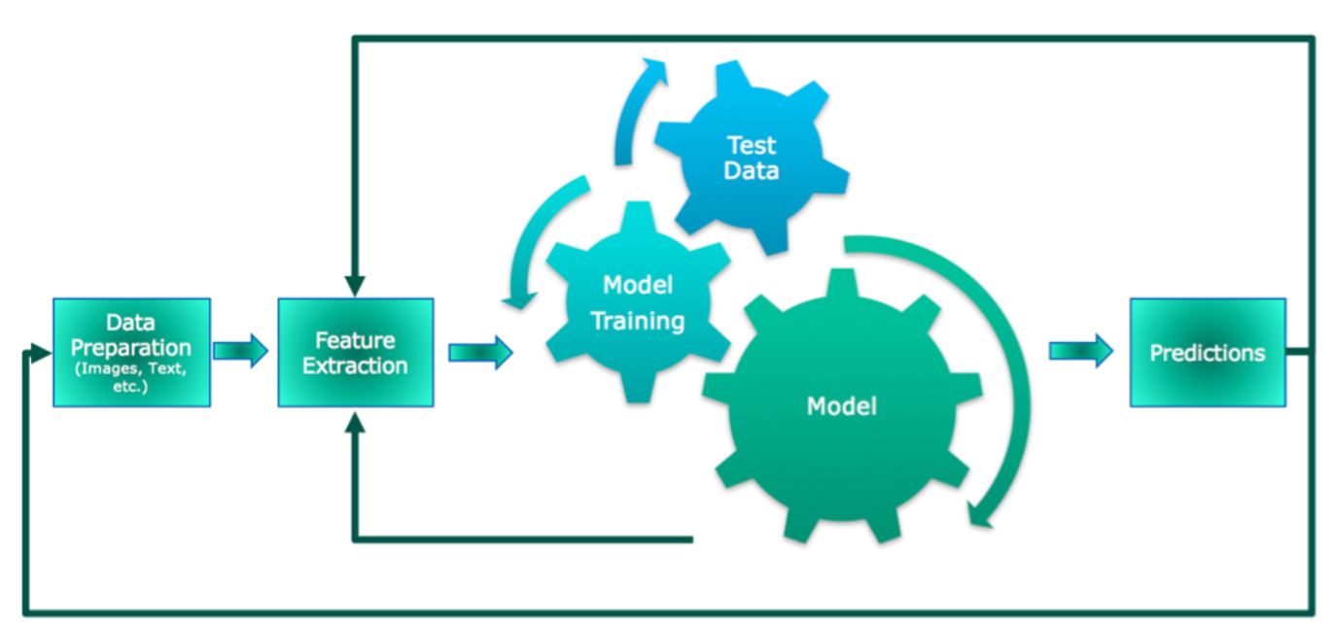
ML processing pipeline

Slide 49
Python in Lab session
Required libraries in Python:
First week:
• NumPy 1.17.4
• SciPy 1.3.1
• scikit-learn 0.22.0
• Matplotlib 3.1.0
• pandas 0.25.3
Second week:
OpenCV
Tensorflow

Slide 50
Why these Python Libraries
NumPy is a library for the Python programming language, adding support for large, multi-dimensional arrays and matrices, along with a large collection of high-level mathematical functions to operate on these arrays.
SciPy is a free and open-source Python library used for scientific computing and technical computing. SciPy contains modules for optimization, linear algebra, integration, interpolation, special functions, FFT, signal and image processing, ODE solvers and other tasks common in science and engineering.

Slide 51
Why these Python Libraries
Scikit-learn (formerly scikits.learn and also known as sklearn) is a free software machine learning library for the Python programming language. It features various classification, regression and clustering algorithms including support vector machines, random forests, gradient boosting, k-means and DBSCAN, and is designed to interoperate with the Python numerical and scientific libraries NumPy and SciPy.

Slide 52
Why these Python Libraries
Pandas is a popular Python package for data science, and with good reason: it offers powerful, expressive and flexible data structures that make data manipulation and analysis easy, among many other things. The DataFrame is one of these structures.
Matplotlib is used for visualization purpose. There are many great visualization packages in Python and Matplotlib is the basic one to serve the purpose.

Slide 53
Assessment of this module
You are given classification and image analysis tasks. You will work on writing your own code to find out the most suitable algorithm based on your evaluation from the training set. You need to submit a report and your code in your final coursework submission.
Please make sure that your code will take the test file name as the only input parameter and output the evaluation metrics, including accuracy, recall and F1 and so on. You are required to summarise the results and write a reflection in your coursework. Please be aware your coursework will be evaluated based on the quality of your code, your report and the reflection on the testing performance

Slide 54
Day 01 Lab session
Practice on the ML processing pipeline:
Follow the tutorial to learn some basic functions of Pandas;
Follow the tutorial to learn conversion between Pandas and Numpy;
Follow the tutorial to learn some basic functions of Matplotlab;
Follow the tutorial to learn sklearn basics;
Practices on given tasks.

Slide 55
Questions?

